Slide 1
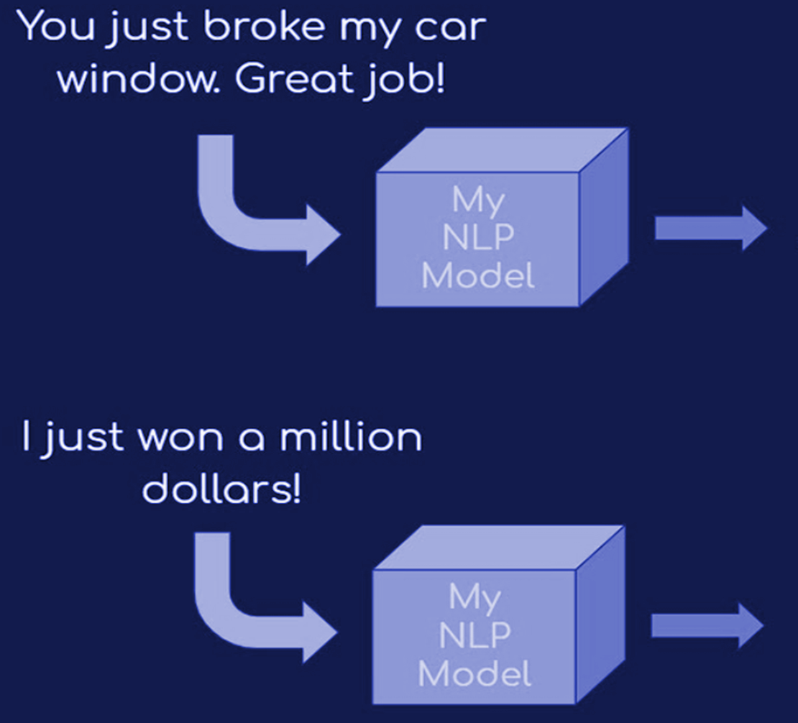
SARCASM DETECTION ON NEWS HEADLINES
PROJECT TEAM MEMBERS
SHRUTI KAMBALI (AI 24)
GHANSHYAM GADEKAR (AI 11)
SAHIL CHIMANE (AI 7)
BHAVESH BHALERAO (AI 3)
SARCASM
?

Slide 2
INTRODUCTION
PROBLEM STATEMENT
OBJECTIVES
Sarcasm in News Headlines
Deep Learning Tools for Sarcasm Detection
Promise of Deep Learning: Sequential Understanding,Semantic Comprehension,Improved Accuracy
Compare the performance of different recurrent neural network (RNN) architectures, including GRU, LSTM, and BLSTM, in sarcasm detection.
Investigate the impact of pre-trained word embeddings (GloVe) on model accuracy and robustness.
Analyze the strengths and weaknesses of each model architecture in the context of sarcasm detection.
Provide insights into the practical application of these models in real-world scenarios, such as news filtering and sentiment analysis.
Contribute to the advancement of natural language processing (NLP) techniques for improved news interpretation and information reliability.

Slide 3
Challenges deep-dive
Sarcasm is often subtle and context-dependent, making it challenging to detect accurately. Headlines may contain indirect cues that require advanced natural language understanding.
Sarcasm-labeled news headlines may be scarce, requiring careful data collection and annotation efforts. Limited data can hinder model training and generalization.
Complex model architectures like BLSTM and the incorporation of GloVe embeddings introduce additional hyperparameters and potential overfitting challenges.
Ambiguity and Subtlety
Data Imbalance
Limited Annotated Data
Generalization
Model Complexity
News datasets may be imbalanced, with a disproportionate number of non-sarcastic headlines compared to sarcastic ones. This can lead to biased model performance.
Complex model architectures like BLSTM and the incorporation of GloVe embeddings introduce additional hyperparameters and potential overfitting challenges.

Slide 4
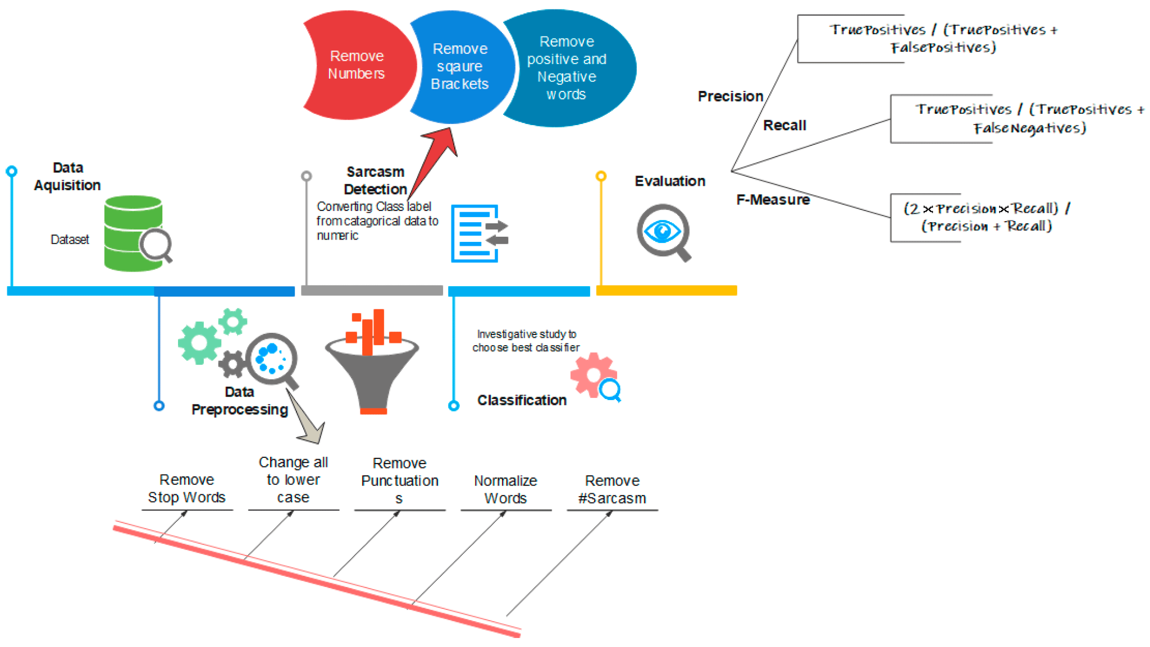
SOLUTION
Data Acquisition
Data Preprocessing
Sarcasm Detection
Evaluation

Slide 5
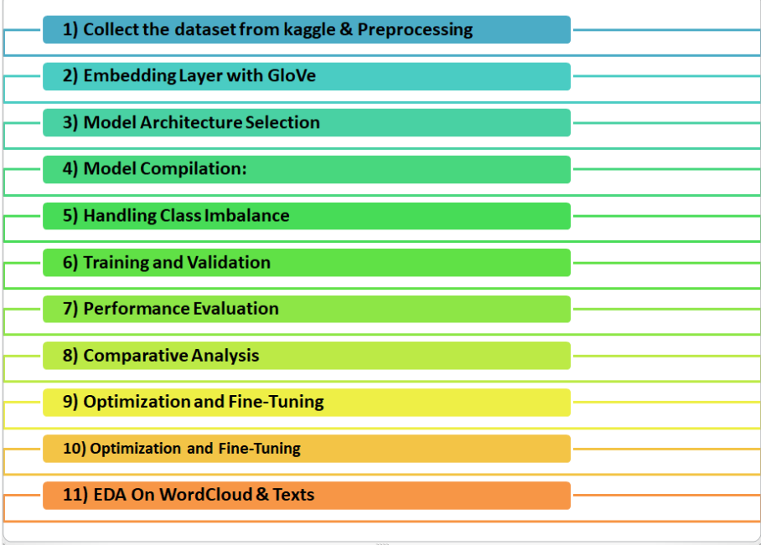
IMPLEMENTATION STEPS

Slide 6
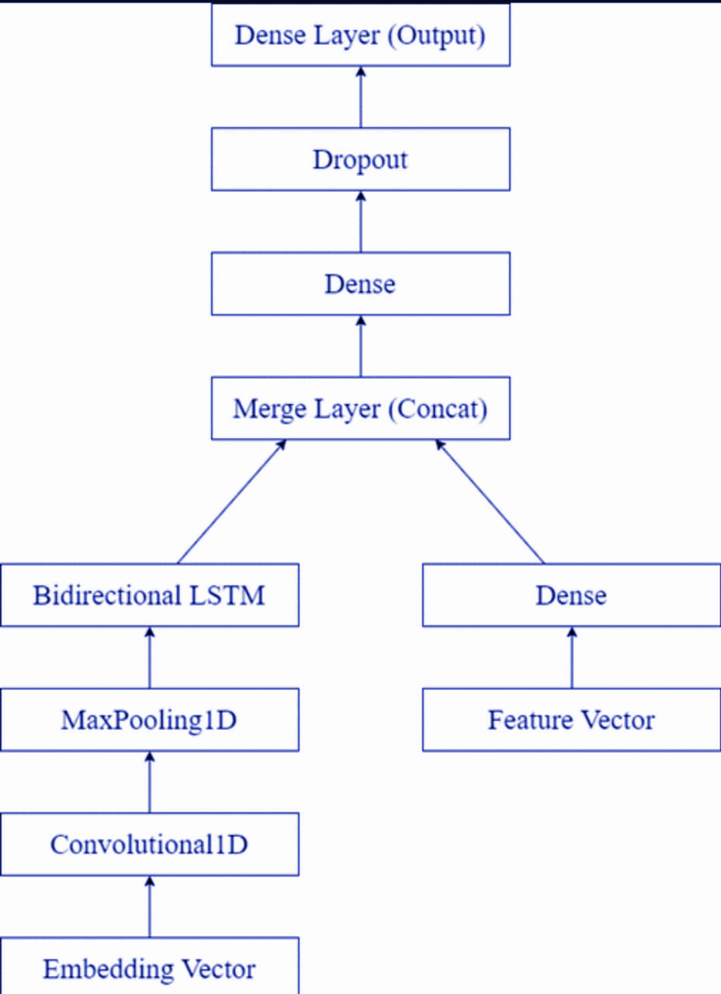
NETWORK ARCHITECTURE

Slide 7
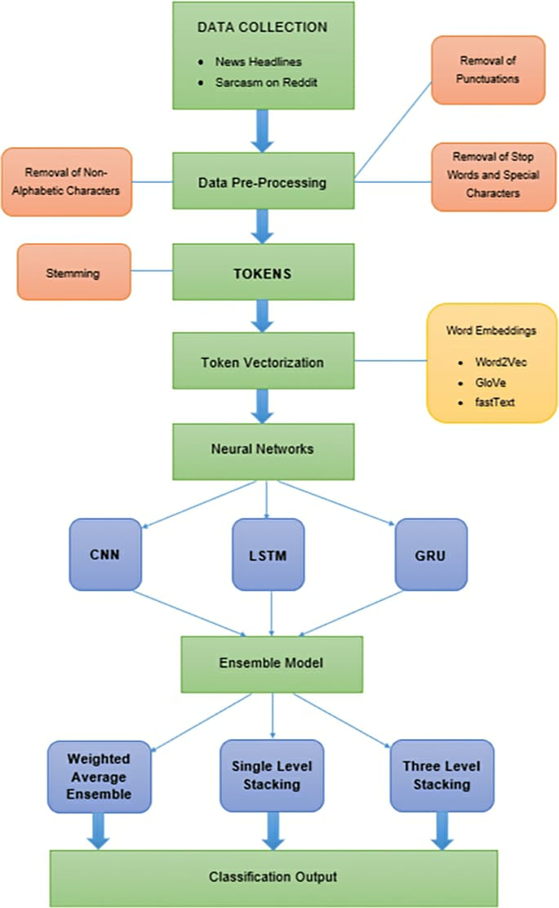
FLOW OF SYSTEM

Slide 8
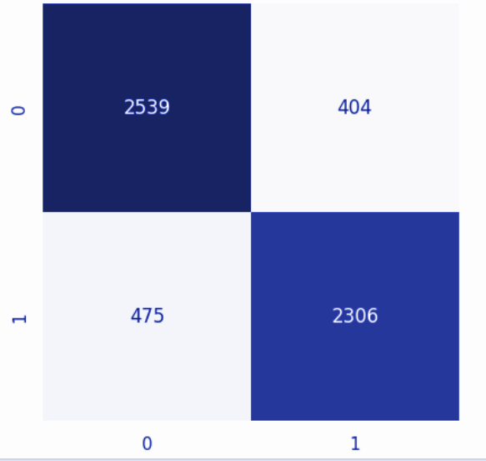
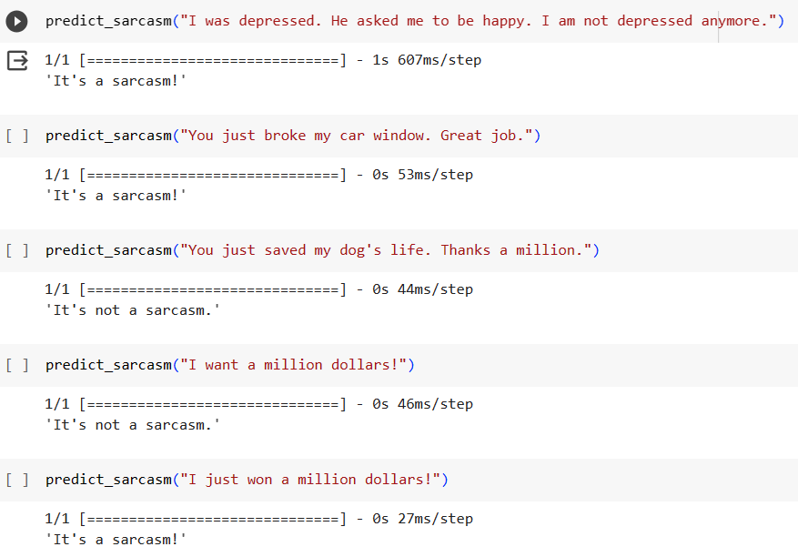
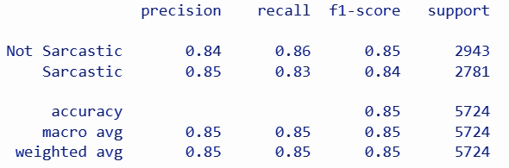
RESULT
EVALUATION METRICS

Slide 9
EVALUATION CRITERIA
Confusion Matrix Analysis
True Positives (TP): Sarcastic headlines correctly classified.
True Negatives (TN): Non-sarcastic headlines correctly classified.
False Positives (FP): Non-sarcastic headlines incorrectly classified as sarcastic.
False Negatives (FN): Sarcastic headlines incorrectly classified as non-sarcastic.
Accuracy (ACC)
The proportion of correctly classified headlines (both sarcastic and non-sarcastic) to the total number of headlines.
05
01
04
Training and validation accuracy
The training accuracy curve shows how well the model fits the training data over time, indicating convergence and potential overfitting. Meanwhile, the validation accuracy curve evaluates the model's ability to generalize to unseen data.
Precision and Recall
Precision: The ratio of correctly predicted sarcastic headlines to all actual sarcastic headlines..
Recall: The ratio of correctly predicted sarcastic headlines to all actual sarcastic headlines.
02
03
. F1-Score
The harmonic mean of precision and recall, combining both metrics into a single value.

Slide 10
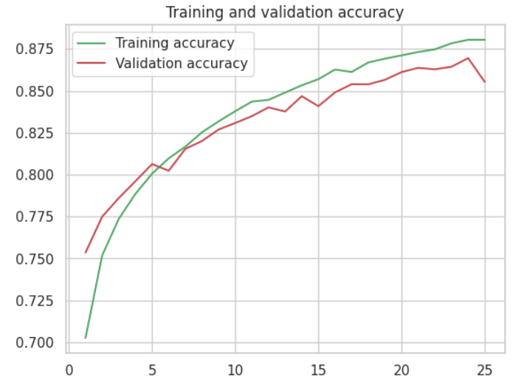
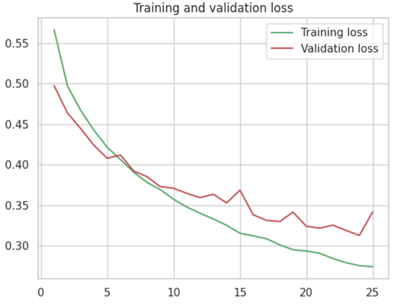
Training loss and validation loss of the Glove-LSTM model.
Training and validation accuracy of the Glove-LSTM model.

Slide 11
CONCLUSION
The integration of LSTM, GRU, and Bidirectional networks, along with GloVe word embeddings, has yielded promising results. These techniques have demonstrated their efficacy in capturing the intricate linguistic cues and contextual nuances that characterize sarcastic expressions. The comparative analysis of these approaches has shed light on their respective strengths and limitations, providing valuable insights for future research and practical applications.
Furthermore, the project has addressed the class imbalance challenge inherent in sarcasm detection tasks, implementing techniques to ensure that the model learns effectively from both sarcastic and non-sarcastic instances. This robustness is
critical for real-world applications where sarcasm detection plays a pivotal role, such as media analysis and content moderation.
By focusing on news headlines as the domain of interest, this research has also contributed to the understanding of sarcasm detection in a specific context. News articles, with their unique linguistic characteristics and sarcasm patterns, present a challenging yet important area of study.

Slide 12





FUTURE SCOPE
Cross-Lingual Sarcasm Detection
Extending sarcasm detection to multiple languages is essential for global news analysis. Research can focus on adapting and training models for languages other than English.
Commercial and Social Applications
Sarcasm detection can be applied in social media sentiment analysis, chatbots, and customer service applications to improve user interactions.
Multimodal Fake News Detection
Integrating sarcasm detection with fake news detection can provide a more comprehensive solution for combating misinformation in news.

